Slide 1



JEEVANTI
LIFE LIVING
BY: TEAM CODE CATALYST

Slide 2

THE HEALTHCARE CHALLENGE
LIMITED ACCESS TO HEALTHCARE IN UNDEVELOPED AREAS:
Rural and undeveloped areas face significant barriers to timely, quality healthcare due to scarce resources and infrastructure.
LACK OF PERSONALIZED CARE:
Current healthcare models are generic, failing to tailor care to individual patient needs.
PREVENTIVE CARE SHORTCOMINGS:
Healthcare largely neglects preventive measures that could reduce disease burdens in undeveloped populations.

Slide 3


INTORDUCTION TO JEEVANTI
ACCESSIBILITY
According to ASER 2021, 67.6% of Indian house holds have smartphones which can help our product/service to reach undeveloped areas. Countries best doctors will be accessible on our app.
PERSONALIZATION
Create an AI-driven platform that utilizes individual patient data—such as medical history, lifestyle factors, and real-time health metrics—to generate personalized care plans.
HEALTH STRATERGIES
Platform that offers best doctors at any time, personalized preventive care programs, including AI-driven risk assessments, educational resources, and reminders for screenings and vaccinations.

Slide 4

KEY FEATURES
AI algorithms to analyze patient’s medical history.
AI can prioritize urgent cases, assist healthcare providers in diagnosing complex conditions, and reduce the time for initial assessments.
Real-time telemedicine platform enabling video consultations and patient-doctor interactions.
Real-time data collection allows for continuous health monitoring, alerting patients and providers of potential issues before they escalate.

Slide 5

TECHNOLOGIES USED
VS CODE
PYTHON
TENSERFLOW
NLTK
OPEN CV
FLASK
GPT API’s
GITHUB LINK FOR SKELETON CODE
https://bit.ly/CodeCatalystSkeletonCode

Slide 6
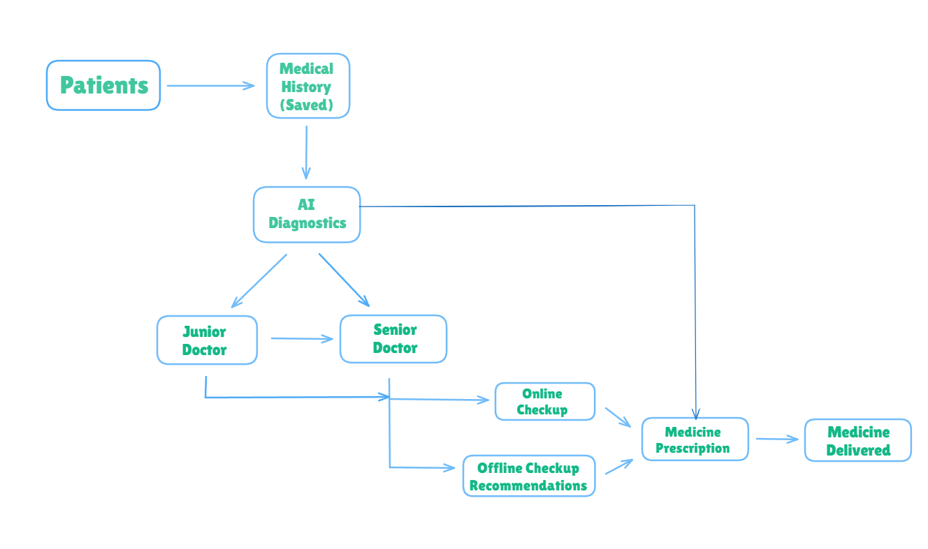
WORK FLOW

Slide 7
BUSINESS MODEL
AI CHATBOT SUBSCRIPTION MODEL
NOMINAL CHECKUP FEE
Jeevanti will charge a percentage of the checkup fee from the doctors, offering a great number of patients(users) to the doctors from all over the country.
Users will pay a subscription fee to access the benefits of the AI chatbot which will assess the patient’s disease and the medicines will be then prescribed by the doctor itself.
DELIVERY AS A SERVICE MODEL
Jeevanti will provide delivery services to partner medical shops through its logistics network. This model involves managing the entire delivery process, from order fulfillment to doorstep delivery. It will charge delivery fees to medical shops for using its delivery services, offering a seamless end-to-end solution for medicines delivery.

Slide 8
THANK YOU
TEAM:
Harshita Pandey (CSE-DS 1st Year)
Prakhar Gupta (CSE-DS 1st Year)
Praver Agarwal (CSE-DS 1st Year)
Aditya Dubey (CSE-DS 1st Year)

